Slide 1
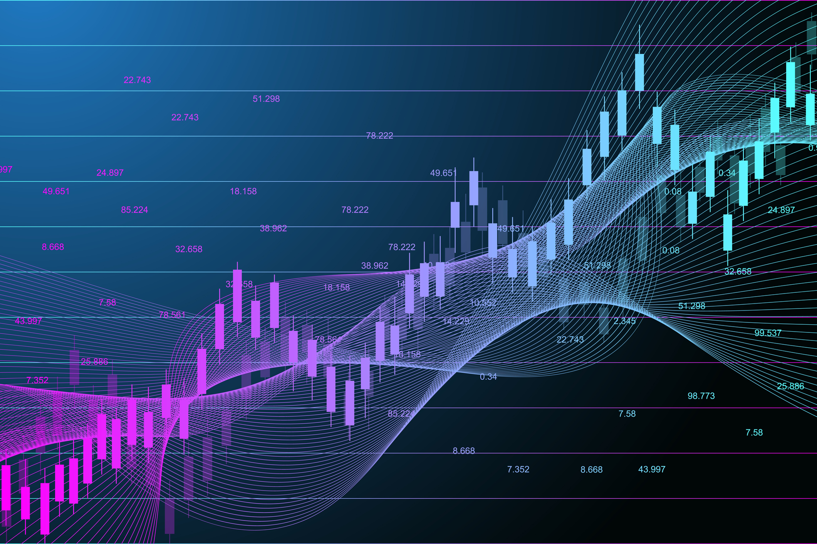

Analyzing Market Trends through Sentiment Analysis
Keerthana, Parth, Prayut, Sirivanth & Shweta

Slide 2






MEET OUR TEAM
Aspect here
Aspect here
Aspect here
SHWETA
PRAYUT
PARTH
Aspect here
Aspect here
SIRIVANTH
KEERTHANA
NLP

Slide 3

AGENDA
01
02
03
04
BUSINESS PROBLEM
EXPLORATORY DATA ANALYSIS
METHODOLOGY
CONCLUSION
BACKGROUND
BUSINESS PROBLEM
Data Definition
Feature Engineering
Feature Engineering
Modeling
Key Findings
Future Implementations

Slide 4

BACKGROUND
The growth of the internet and the widespread use of social media have significantly impacted businesses, stocks, and other aspects of the economy.

Slide 5



BACKGROUND
The growth of the internet and the widespread use of social media have significantly impacted businesses, stocks, and other aspects of the economy.
The sentiment on social media and online forums about the company often influences its stock price. For example, in 2018, Musk tweeted that he was considering taking Tesla private at $420 per share, which caused a surge in the stock price.
The growth of the internet and the widespread use of social media have significantly impacted businesses, stocks, and other aspects of the economy.
In 2017, a public relations crisis when a video showing a passenger being violently dragged off a flight went viral on social media. The negative sentiment on social media led to a sharp drop in United's stock price, and the company faced widespread criticism and boycotts.
In early 2021, a group of retail investors on Reddit's WallStreetBets forum coordinated a buying spree of shares of GameStop, a struggling video game retailer. This caused a sharp rise in GameStop's stock price, triggering a short squeeze that resulted in huge losses for several hedge funds that had bet against the stock.
Notes:
In a study by Shareablee, companies with a strong social media presence experienced a 4.5% increase in stock price, compared to a 1.6% increase for companies with weaker social media presence. This shows that social media sentiment can influence investor perceptions and stock performance.
Social media sentiment can also impact brand reputation. A study by Sprout Social found that 83% of consumers say that they have had a negative experience with a brand on social media. Negative sentiment on social media can quickly spread and damage a company's reputation.
According to a study by BrightLocal, 91% of consumers read online reviews before making a purchase decision. Moreover, businesses with positive online reviews are more likely to attract customers and generate revenue.

Slide 6



BUSINESS PROBLEM & IMPACT
BUSINESS PROBLEM
SOLUTION
Determine the sentiment of a community towards companies and their effect on the company in the stock market by analyzing their online presence on various social media platforms.
Provide valuable insights into market sentiment and investor behavior by building Natural Language Processing models over Reddit WallStreetBets, which can be used to understand a companies' social media standing.

Slide 7
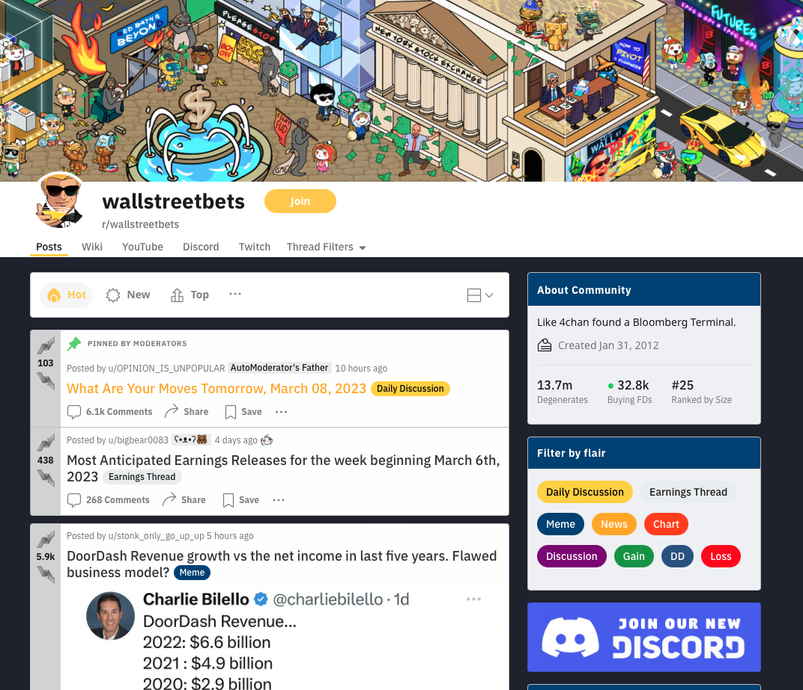
WHY REDDIT WALLSTREETBETS?
The GameStop Frenzy incident highlighted the power of social media and its effect towards a particular stock or company.
WallStreetBets, the 25th largest Reddit community with 13.7 million followers, is a significant platform for finance and investing discussions.
Sentiment analysis can help investors identify trends and fluctuations in real-time and understand the impact of real-world events on the stock market.
Notes:
This idea was inspired from the ‘GameStop Frenzy’. During this, a subreddit group decided to make several posts beginning on January 22, 2021, on Reddit to purchase the GameStop shares, driving up the price some 600% in four days, thus forcing those large Wall Street firms who bet that the stock would go down, to lose billions in its portfolio. (Mention the peleton example too)​
WallStreetBets is a popular subreddit community that primarily focuses on discussions related to Wall Street and stocks. As the 25th largest Reddit group, it has a significant following of 13.7 million users who are interested in finance and investing.​
Sentiment analysis is important for stocks because it can help investors to understand the overall mood and attitudes of the market towards a particular stock or company. The emotions and opinions of investors can have a significant impact on stock prices, and sentiment analysis can help to identify these trends and fluctuations in real-time
This idea was inspired from the ‘GameStop Frenzy’. During this, a subreddit group decided to make several posts beginning on January 22, 2021, on Reddit to purchase the GameStop shares, driving up the price some 600% in four days, thus forcing those large Wall Street firms who bet that the stock would go down, to lose billions in its portfolio. (Mention the peleton example too)​
WallStreetBets is a popular subreddit community that primarily focuses on discussions related to Wall Street and stocks. As the 25th largest Reddit group, it has a significant following of 13.7 million users who are interested in finance and investing.​
Sentiment analysis is important for stocks because it can help investors to understand the overall mood and attitudes of the market towards a particular stock or company. The emotions and opinions of investors can have a significant impact on stock prices, and sentiment analysis can help to identify these trends and fluctuations in real-time

Slide 8




DATA PROFILE
r/WallStreetBets & Stock Data from Yahoo Finance
r/WallStreetBets Data Source
TIMELINE
SIZE
DATA POINTS
FEATURES
2012-2022
~800 MB
2,218,243
(Before Preprocessing)
14
+ 6 stock trends
(Before Preprocessing)
Notes:
Two data sets were used …..
Visual Crossing is a leading provider of weather data and enterprise analysis tools to data scientists, business analysts, professionals, and academics. Founded in 2003, our mission has always been to empower data consumers and analysts to make better decisions based on high-quality, easy-to-access data.
Missing values (removed, no imputation)
Some extremely skewed variables

Slide 9
DATA PROFILE
Snapshot of Data Set
id | title | body | upvote_ratio | author | created_utc | score | num_comments | permalink
11fc79h | Easy 50k on 🔻NVAX goin Bankrupt |  | 1.0 | SkylerPhoenixx | 1677696713 | 1 | 3 | /r/wallstreetbets/comments/11fc79h/easy_50k_on...
11fbkiv | Branson collecting my WSB entry fee | My last post with this report seemed to do wel... | 1.0 | mytendies | 1677695792 | 1 | 2 | /r/wallstreetbets/comments/11fbhax/cheapest_pu...
Unique Post ID
Post Body
Reddit User ID
Post Score
Permalink
Post Title
# Likes on the post
Time Posted
# Comments on the post
Notes:
Two data sets were used …..
Visual Crossing is a leading provider of weather data and enterprise analysis tools to data scientists, business analysts, professionals, and academics. Founded in 2003, our mission has always been to empower data consumers and analysts to make better decisions based on high-quality, easy-to-access data.
Missing values (removed, no imputation)
Some extremely skewed variables

Slide 10
FEATURE ENGINEERNG
POST TITLE
POST BODY
YAHOO DATA
Removed Stopwords, punctuations and lemmatized
Removed emojis/emoticons
Dropped rows which were null (only 4 present)
Removed StopWords, punctuations, tabs, new lines and lemmatized
Removed redundant post data
Removed hyperlinks, tags and mentions
Removed daily trading discussion threads and AutoModerator Warnings
Forward filled for missing values
Calculated daily stock returns and polarity returns
Standardization
Notes:
Two data sets were used …..
Visual Crossing is a leading provider of weather data and enterprise analysis tools to data scientists, business analysts, professionals, and academics. Founded in 2003, our mission has always been to empower data consumers and analysts to make better decisions based on high-quality, easy-to-access data.
Missing values (removed, no imputation)
Some extremely skewed variables

Slide 11
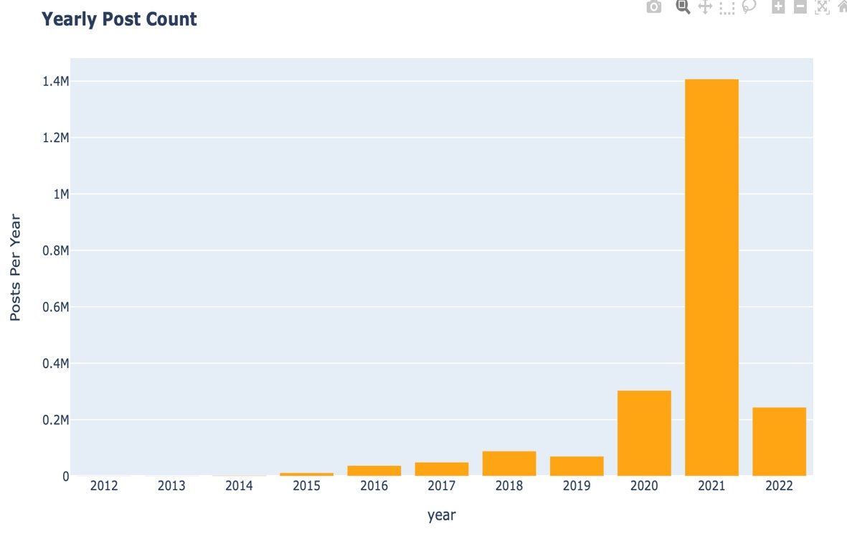
DATA LIMITATIONS
Unnecessary/ Redundant columns
Missing values
Data is not balanced over the years (More posts after 2020)
Slang and informal language
Biased sample
Contextual ambiguity due to limited context. Reddit posts lack in nuance in terms of context
Misspellings and acronyms
Notes:
Unnecessary/ Redundant columns
Missing values
Data is not balanced over the years (More posts after 2020 – see the graph)
Slang and informal language:
Biased sample: Reddit users are not a representative sample of the general population.
Contextual ambiguity due to Limited context: Reddit posts and comments are often brief and lack the nuance and context necessary for a full understanding of the topic. This can limit the ability to draw meaningful conclusions from the data.
Misspellings and acronyms

Slide 12
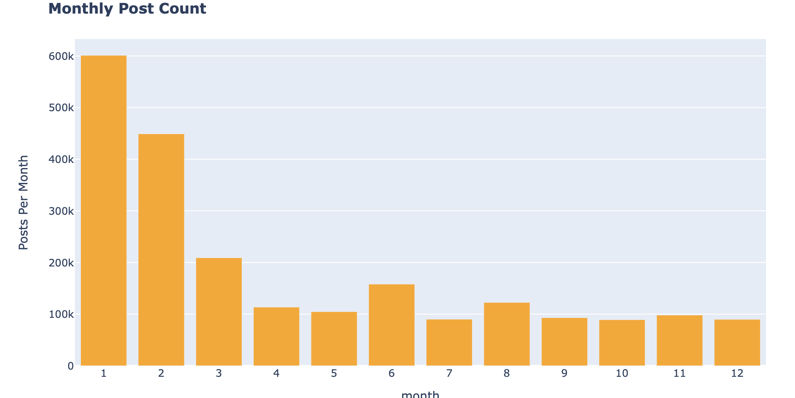
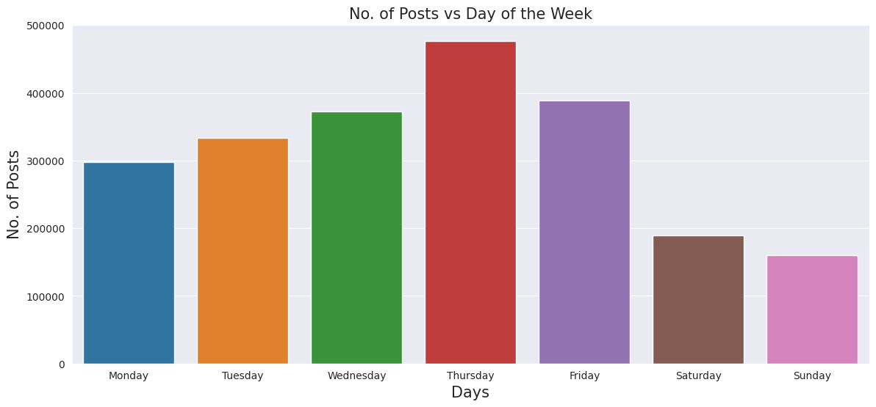
EXPLORATORY DATA ANALYSIS
Post distribution in the Reddit WallStreetBets dataset
Notes:
Unnecessary/ Redundant columns
Missing values
Data is not balanced over the years (More posts after 2020 – see the graph)
Slang and informal language:
Biased sample: Reddit users are not a representative sample of the general population.
Contextual ambiguity due to Limited context: Reddit posts and comments are often brief and lack the nuance and context necessary for a full understanding of the topic. This can limit the ability to draw meaningful conclusions from the data.
Misspellings and acronyms

Slide 13
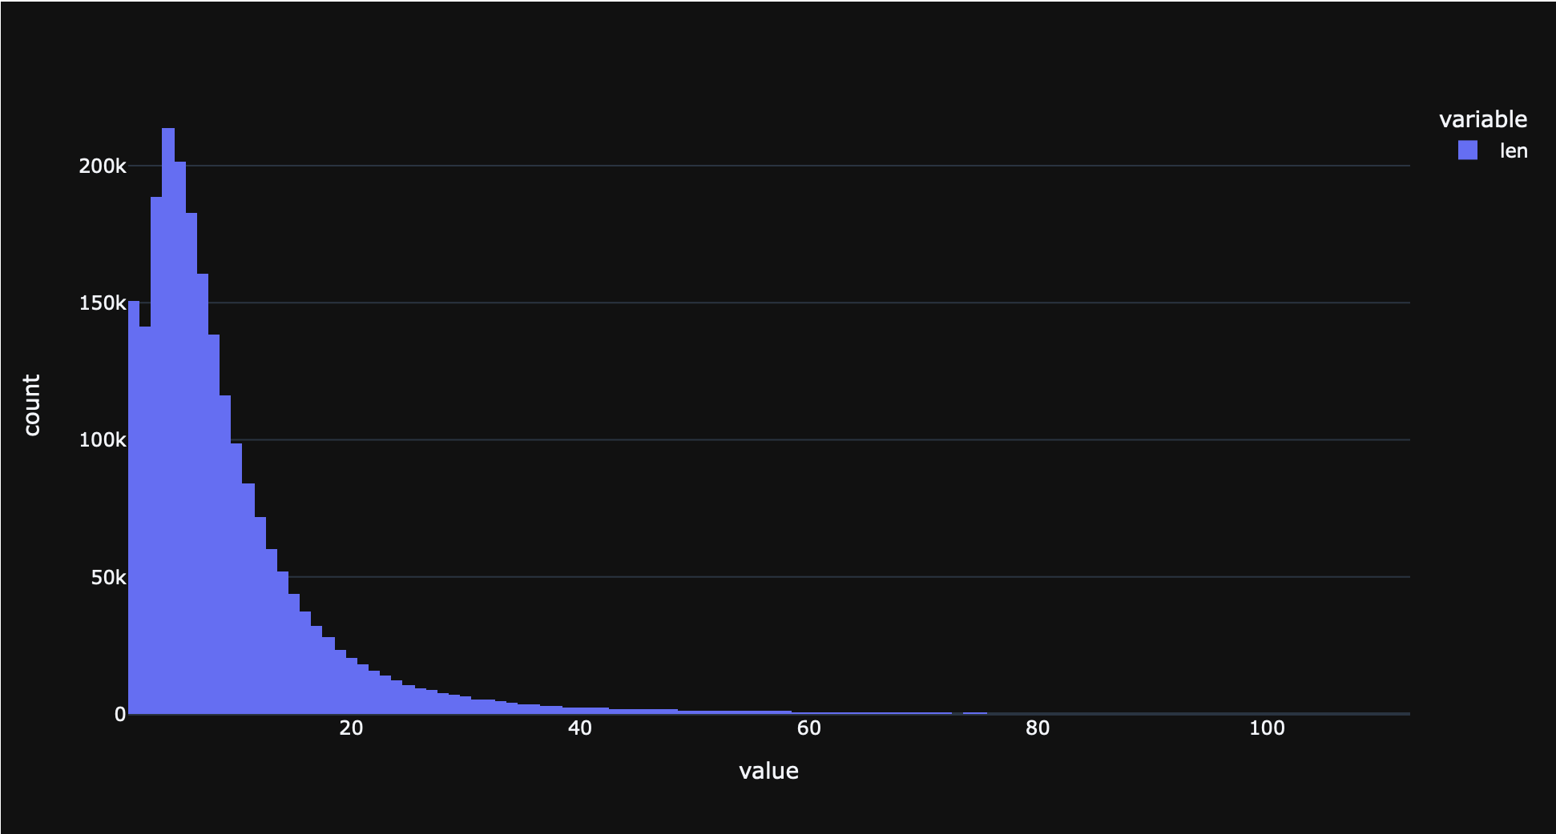
EXPLORATORY DATA ANALYSIS
TOTAL AND AVERAGE WORD COUNT FOR TITLES
19,844,206
8.95
TOTAL NUMBER OF WORDS
AVERAGE NUMBER OF WORDS
MAX NUMBER OF WORDS IN A TITLE
112
Notes:
Get better graph labels/legend?

Slide 14
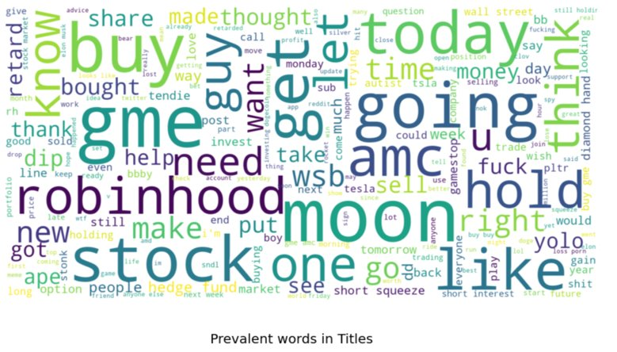
EXPLORATORY DATA ANALYSIS
Word Cloud Based on Titles
Notes:
Unnecessary/ Redundant columns
Missing values
Data is not balanced over the years (More posts after 2020 – see the graph)
Slang and informal language:
Biased sample: Reddit users are not a representative sample of the general population.
Contextual ambiguity due to Limited context: Reddit posts and comments are often brief and lack the nuance and context necessary for a full understanding of the topic. This can limit the ability to draw meaningful conclusions from the data.
Misspellings and acronyms

Slide 15
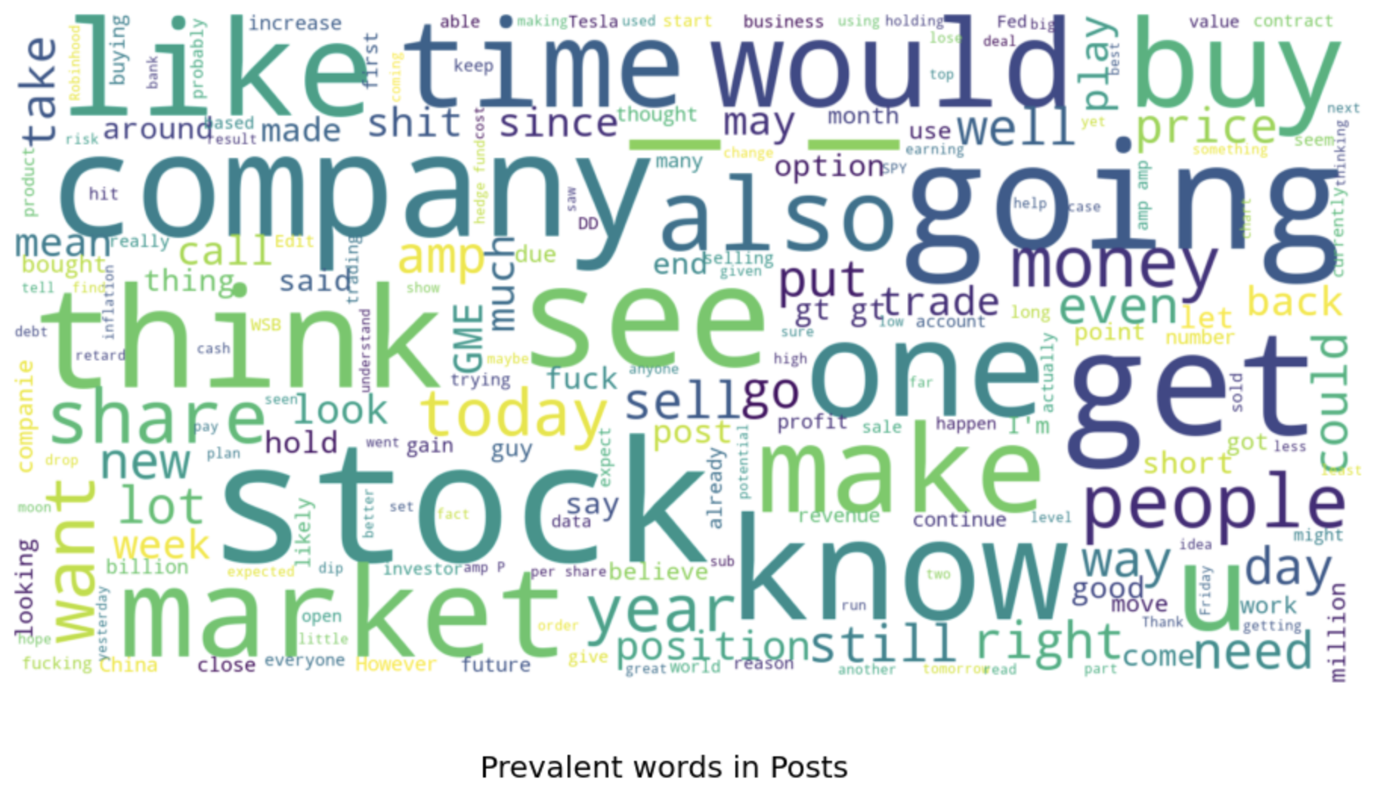
EXPLORATORY DATA ANALYSIS
Word Cloud Based on Body
Notes:
Unnecessary/ Redundant columns
Missing values
Data is not balanced over the years (More posts after 2020 – see the graph)
Slang and informal language:
Biased sample: Reddit users are not a representative sample of the general population.
Contextual ambiguity due to Limited context: Reddit posts and comments are often brief and lack the nuance and context necessary for a full understanding of the topic. This can limit the ability to draw meaningful conclusions from the data.
Misspellings and acronyms

Slide 16
MODELING
Models Applied
Latent Dirichlet Allocation | LDA | Topic Modelling
spaCy NER | Named Entity Recognition | Organization labelling
Valence Aware Dictionary for Sentiment Reasoning | VADER | Sentiment Compounding
TextBlob Pattern Analyzer |  | Polarity and Subjectivity
Aspect Based Sentiment Analysis | ABSA | Aspect based Sentiment
Naive Bayes |  | Probabilistic algorithm

Slide 17
MODELING
Latent Dirichlet Allocation (LDA)
Calculate Document to topic count, frequency of the word with respect to each topic
Calculate probability of word to topic
Create Documents of Post titles
Tokenizing, Stopping & Stemming
Robinhood app, stock trading, and related terminology like "dd" (due diligence), "rh" (Robinhood), and "stonks".
Short selling, stock prices, and related terms like "squeeze" (short squeeze), "tendies" (profits)
Hedge funds, news, and various other topics like the SEC (Securities and Exchange Commission), Donald Trump, and cryptocurrencies.
Buying, holding, and selling stocks, as well as various other related terms like "dip" (a temporary drop in stock prices) and "earnings".
Specific stocks that have gained a lot of attention on WSB, including AMC, Blackberry, Nokia, and Dogecoin, as well as related terms like "moon" and "rocket".
Discussions related to investing, including the WSB community itself, as well as related terms like "retard" (used humorously) and "gain".
GameStop (GME), a stock that gained a lot of attention on WSB in early 2021, as well as related terms like "next" and "buy".
Notes:
Refine algorithms
Valiation Topics

Slide 18
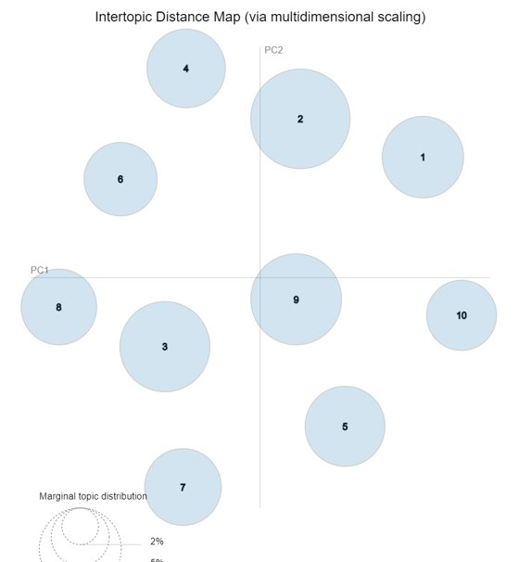
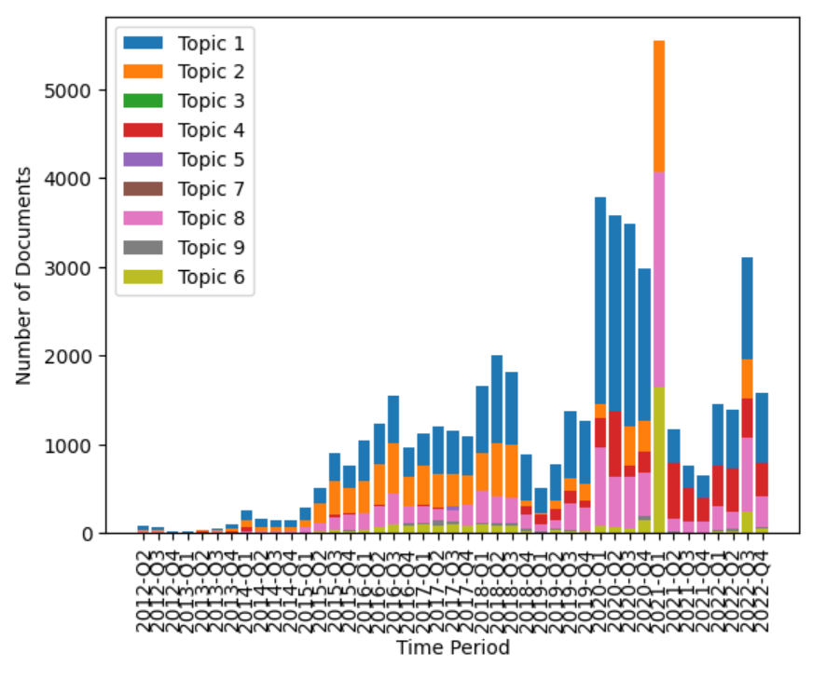
MODELING
LDA Distribution and Intertopic distance

Slide 19
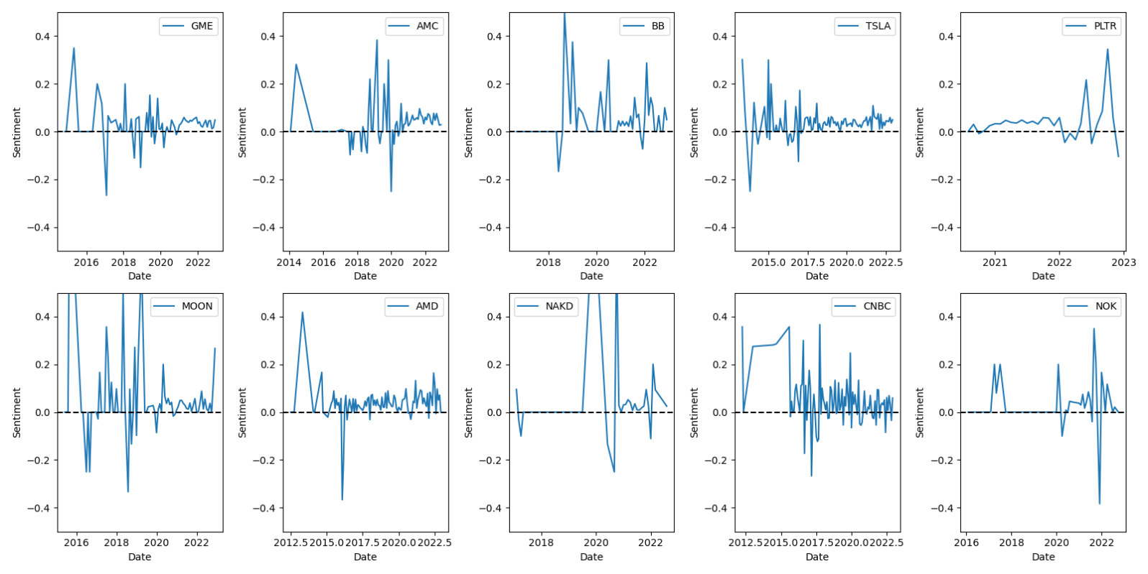
MODELING
Sentiment analysis - Top 10 stocks
Game Stop
AMC Theatres
BlackBerry
Tesla
Palantir Tech.
Direxion Moonshot Innovators ETF
AMD
NAKD Brand
CNBC
Nokia
*retrieved using spaCy NER

Slide 20
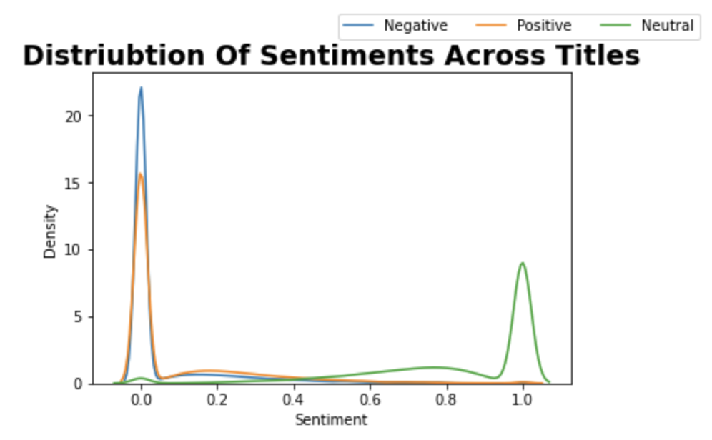
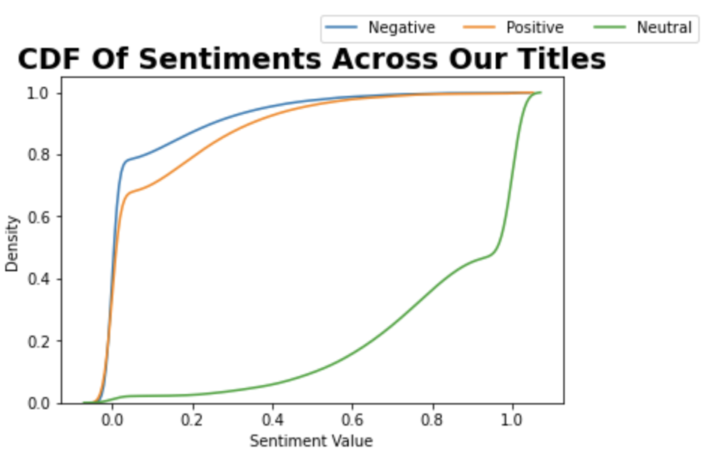
MODELING
VADER & Pattern Analyzer
Rule-based sentiment analysis tool specifically designed for sentiment analysis of social media texts.
Tokenizing & cleaning the data
Pre-built lexicon used to calculate sentiment
Aggregates polarity, intensity, and context of the words to get overall sentiment score between -1 to 1
Score is post-processed to produce a binary classification of the sentiment as either positive, negative, or neutral
Notes:
VADER (Valence Aware Dictionary and sEntiment Reasoner) is a rule-based sentiment analysis tool specifically designed for sentiment analysis of social media texts.
Text preprocessing: The first step is to preprocess the text data by tokenizing the text into individual words and removing stop words, punctuation, and other irrelevant information.
Sentiment analysis: The next step is to analyze the sentiment of each individual word in the text using a pre-built sentiment lexicon that contains information about the polarity and intensity of words. VADER uses a combination of word-level and context-level information to calculate the sentiment score for each word.
Aggregating sentiment scores: Once the sentiment score for each word has been calculated, VADER aggregates the scores to produce an overall sentiment score for the text. The algorithm takes into account the polarity, intensity, and context of the words to produce a sentiment score that ranges from -1 (most negative) to +1 (most positive).
Post-processing: In the final step, the sentiment score is post-processed to produce a binary classification of the sentiment as either positive, negative, or neutral. This is done using pre-defined thresholds for the sentiment score that are based on empirical observations of the distribution of sentiment scores in social media texts.
Neutral 1207127 ~ 51% Positive 627067 ~ 30% Negative 384049 ~ 19%

Slide 21
MODELING
What were the positive topics?
"GameStop stock hype": gme, moon, help, bb, friend, need, wsb, amc, cnbc
"Short squeeze and interest": gme, short, amc, squeeze, interest, love, ape, please, someone
"Excitement and party atmosphere": gme, like, amc, look, 💎, stock, late, hold, moon
"Rocket emojis and money-making": 🚀, gme, make, amc, money, like, stock, cnbc,
"Future speculation and hype": gme, pltr, moon, amc, bb, go, ready, wish, next, 🚀🚀🚀
"AMC stock discussion": amc, gme, good, ape, stock, bb, buy, hand, diamond
"Investment options": yolo, tesla, gme, call, tsla, amd, pltr, stock, update, put
Notes:
Blur slurs

Slide 22
MODELING
What were the negative topics?
GAMESTOP
That's all people talked about and not everyone was happy...
Notes:
Blur slurs

Slide 23
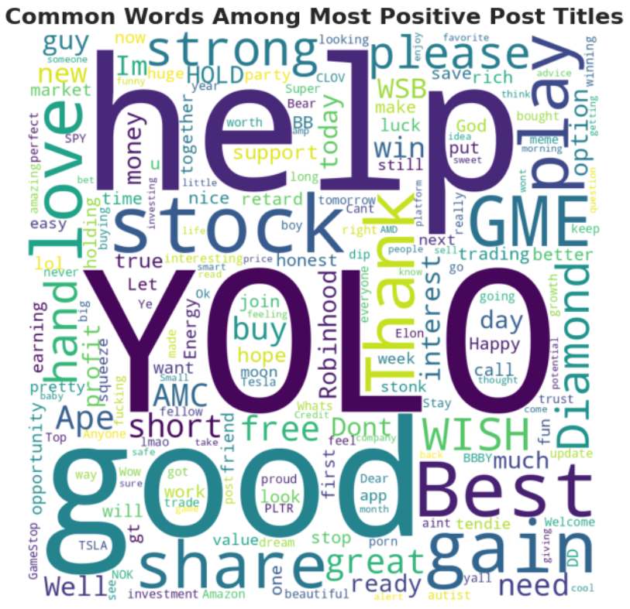
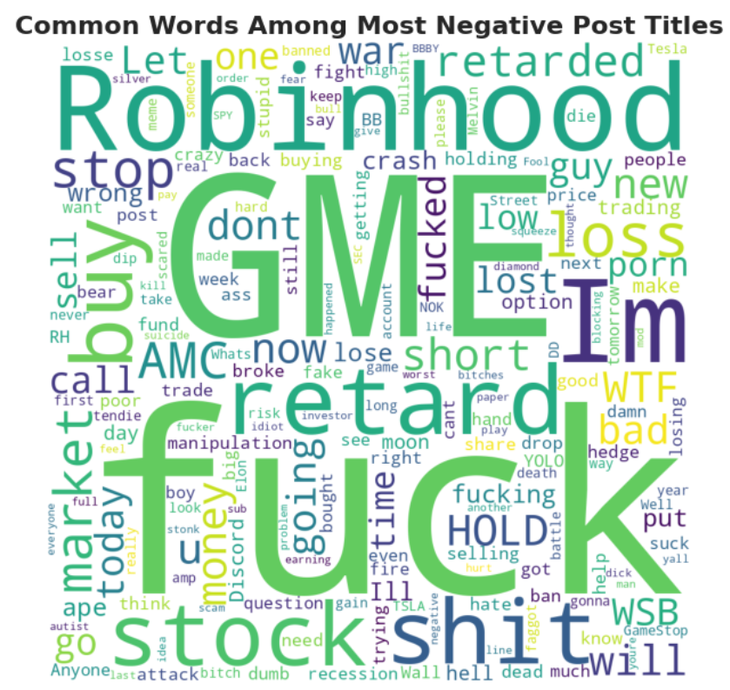
MODELING
Word Cloud Based on Negative & Positive Sentiment
Notes:
Blur slurs

Slide 24
MODELING
Aspect Based Sentiment Analysis (ABSA)
ABSA is a natural language processing technique that focuses on identifying the aspects or attributes of a product, service or entity that are being discussed in a text, and analyzing the sentiment associated with each aspect.
Aspect extraction: This is done using techniques such as rule-based parsing, named entity recognition, or machine learning models.
Sentiment analysis: Using a variety of sentiment analysis techniques, such as lexicon-based methods, machine learning models or hybrid approaches.
Aspect-level sentiment aggregation: Once the sentiment score for each aspect has been calculated, ABSA aggregates the scores to produce an overall sentiment score for the product, service or entity at the aspect level.
Document-level sentiment analysis: Combines the aspect-level sentiment scores to produce an overall sentiment score for the entire document.
“Amazon (AMZN) and Microsoft (MSFT). Amazon has been dominating the e-commerce space for years! But unfortunately, Microsoft has been lagging”
Symbol | pos_sentiment | neu_sentiment | neg_sentiment
AMZN | 1.87197 | 0.11727 | 1.01076
MSFT | 0.08516 | 0.09648 | 2.81836
{'label': 'neutral', 'score': 0.8062297701835632}
Notes:
Aspect-Based Sentiment Analysis (ABSA) is a technique that helps computers understand and analyze opinions expressed in text towards specific aspects or features of a product, service, or topic. It helps identify what people like or dislike about different parts of something, like a restaurant's food, service, or atmosphere. ABSA is useful for businesses to understand customer feedback and make improvements. To do ABSA, computers use different techniques and tools to analyze text and determine which aspects are positive, negative, or neutral
iPhone camera is very nice but battery is bad. (Aspect is battery and camera)
ABSA (Aspect-Based Sentiment Analysis) is a natural language processing technique that focuses on identifying the aspects or attributes of a product, service or entity that are being discussed in a text, and analyzing the sentiment associated with each aspect. Here are the main steps involved in ABSA:
Aspect extraction: The first step is to identify the aspects or attributes of the product, service or entity that are being discussed in the text. This is done using techniques such as rule-based parsing, named entity recognition, or machine learning models.
Sentiment analysis: The next step is to analyze the sentiment of each aspect that has been identified. This can be done using a variety of sentiment analysis techniques, such as lexicon-based methods, machine learning models or hybrid approaches.
Aspect-level sentiment aggregation: Once the sentiment score for each aspect has been calculated, ABSA aggregates the scores to produce an overall sentiment score for the product, service or entity at the aspect level. This can be done using a variety of aggregation methods, such as simple averaging or more complex models that take into account the importance of each aspect.
Document-level sentiment analysis: In the final step, ABSA combines the aspect-level sentiment scores to produce an overall sentiment score for the entire document. This can be done using a variety of methods, such as simple averaging, weighted averaging or more complex models that take into account the relationship between the different aspects and their overall impact on the sentiment of the document.
Overall, ABSA is a powerful technique for analyzing the sentiment of texts that discuss multiple aspects of a product, service or entity. It can be used for a wide range of applications, such as market research, customer feedback analysis, and social media monitoring.

Slide 25
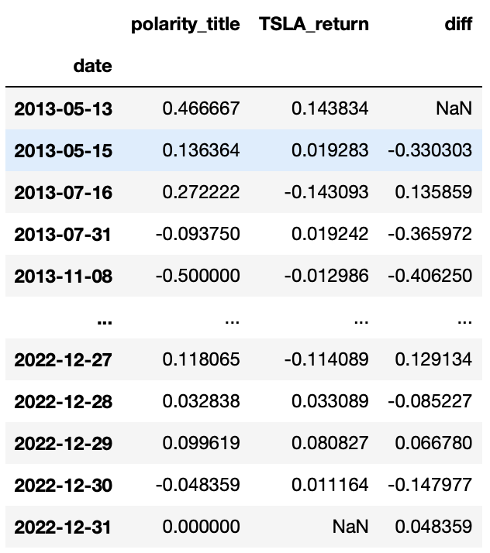
MODELING
Is there a correlation between the sentiment expressed on WallStreetBets and the actual stock price movements?
There was a very weak positive correlation between bullish sentiment expressed on the forum and stock price movements, but no significant correlation between bearish sentiment and stock price movements.
Notes:
A bull market is the condition of a financial market in which prices are rising or are expected to rise.
It's important to note that sentiment expressed on online forums like WallStreetBets may not necessarily be representative of the broader market sentiment, and stock prices are influenced by a multitude of factors beyond just online sentiment. Therefore, it's important to approach any analysis of online sentiment and stock price movements with caution and keep in mind that correlation does not necessarily imply causatio

Slide 26
KEY FINDINGS
The dominant sentiment of WallStreetBets posts is neutral.
The sentiments of both bodies and titles is not stationary over our timeline and it seems there is an incline in the positivity of the posts.
Looking at the top 10 discussed organizations we see that the dominant sentiment is positive, there is also an example for a very discussed topic with dominant negative sentiment.
Based on additonal external new sources, WallStreetBets has demonstrated the ability to influence stock prices through coordinated buying and selling activity.
Only 450 words are needed to account for 79% of the variability in the text of WallStreet related posts titles.
WallStreetBets posts have no significant correlation between its sentiment and stock price movements.
Notes:
ABSA (Aspect-Based Sentiment Analysis) is a natural language processing technique that focuses on identifying the aspects or attributes of a product, service or entity that are being discussed in a text, and analyzing the sentiment associated with each aspect. Here are the main steps involved in ABSA:
Aspect extraction: The first step is to identify the aspects or attributes of the product, service or entity that are being discussed in the text. This is done using techniques such as rule-based parsing, named entity recognition, or machine learning models.
Sentiment analysis: The next step is to analyze the sentiment of each aspect that has been identified. This can be done using a variety of sentiment analysis techniques, such as lexicon-based methods, machine learning models or hybrid approaches.
Aspect-level sentiment aggregation: Once the sentiment score for each aspect has been calculated, ABSA aggregates the scores to produce an overall sentiment score for the product, service or entity at the aspect level. This can be done using a variety of aggregation methods, such as simple averaging or more complex models that take into account the importance of each aspect.
Document-level sentiment analysis: In the final step, ABSA combines the aspect-level sentiment scores to produce an overall sentiment score for the entire document. This can be done using a variety of methods, such as simple averaging, weighted averaging or more complex models that take into account the relationship between the different aspects and their overall impact on the sentiment of the document.
Overall, ABSA is a powerful technique for analyzing the sentiment of texts that discuss multiple aspects of a product, service or entity. It can be used for a wide range of applications, such as market research, customer feedback analysis, and social media monitoring.

Slide 27
FUTURE SCOPE
Expand the analysis to other subreddits or social media platforms - By analyzing data from other subreddits or social media platforms, investors could gain a more complete understanding of trends and sentiment.
Incorporate additional data sources - In addition to analyzing posts and comments, investors could also incorporate data from news articles, financial reports, and other sources to get a more holistic view of the market.
Develop predictive models - By analyzing historical data and market trends, investors could potentially develop predictive models that could help identify emerging trends or anticipate changes in the market.
Explore the impact of sentiment on specific stocks or sectors - By focusing on specific stocks or sectors, investors could explore the impact of sentiment on price movements and potentially identify opportunities for profit.
Notes:
ABSA (Aspect-Based Sentiment Analysis) is a natural language processing technique that focuses on identifying the aspects or attributes of a product, service or entity that are being discussed in a text, and analyzing the sentiment associated with each aspect. Here are the main steps involved in ABSA:
Aspect extraction: The first step is to identify the aspects or attributes of the product, service or entity that are being discussed in the text. This is done using techniques such as rule-based parsing, named entity recognition, or machine learning models.
Sentiment analysis: The next step is to analyze the sentiment of each aspect that has been identified. This can be done using a variety of sentiment analysis techniques, such as lexicon-based methods, machine learning models or hybrid approaches.
Aspect-level sentiment aggregation: Once the sentiment score for each aspect has been calculated, ABSA aggregates the scores to produce an overall sentiment score for the product, service or entity at the aspect level. This can be done using a variety of aggregation methods, such as simple averaging or more complex models that take into account the importance of each aspect.
Document-level sentiment analysis: In the final step, ABSA combines the aspect-level sentiment scores to produce an overall sentiment score for the entire document. This can be done using a variety of methods, such as simple averaging, weighted averaging or more complex models that take into account the relationship between the different aspects and their overall impact on the sentiment of the document.
Overall, ABSA is a powerful technique for analyzing the sentiment of texts that discuss multiple aspects of a product, service or entity. It can be used for a wide range of applications, such as market research, customer feedback analysis, and social media monitoring.
Focus on "meme stocks": WallStreetBets has been known to focus on certain "meme stocks" that have gained popularity through social media and internet forums, such as GameStop and AMC.

Slide 28
THANK YOU!

